Slide 1

Material Classification Protocol
New User guide

Slide 2
Material Classification Protocol
New User guide
Overview – what is the Protocol for?
Annual application process
Extracting works permit & excavation registration data from Street Manager
Quarterly results return process
Uploading UKAS lab results to Street Manager
Sector contacts

Slide 3
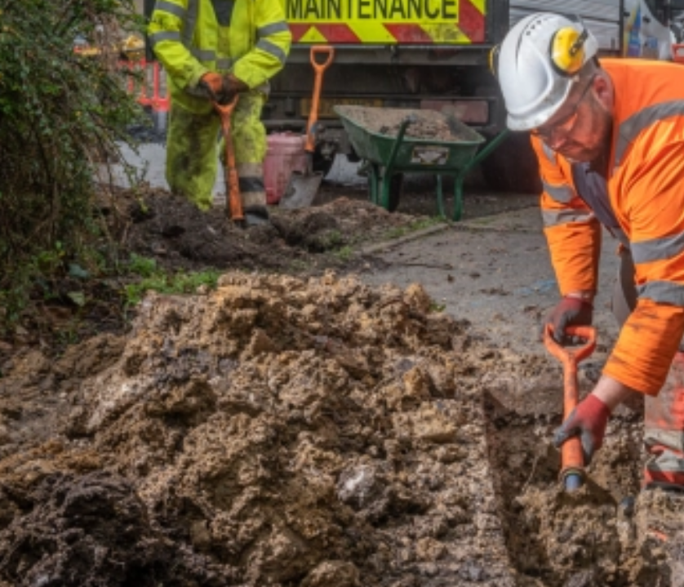

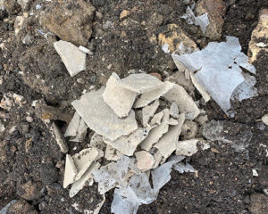
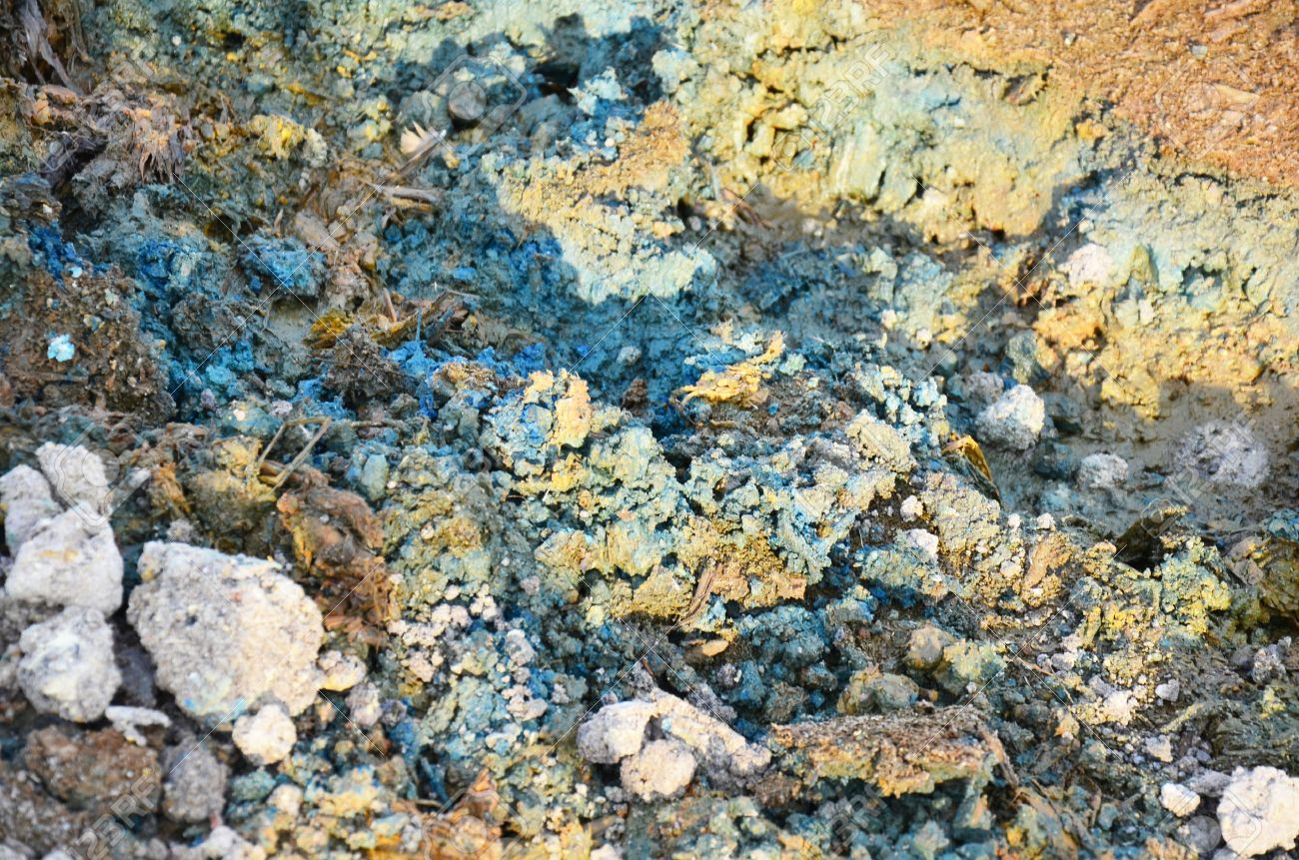
Material Classification Protocol
Overview – what is the Protocol for?
The utility and highways sectors complete millions of excavations in both public and private land annually. Correct classification of waste materials as hazardous (e.g. containing asbestos, heavy metals, petroleum hydrocarbons, etc.) or non-hazardous without drastically increasing the duration and impact of roadworks presents an enormous challenge.
Following 8+ years of discussion with the Environment Agency and thousands of laboratory tests across industry, Streetworks UK have developed an on-site visual classification protocol for short duration works (<10 days) that achieves a very high classification accuracy.
Use of this protocol allows organisations to meet their environmental responsibilities for accurate classification and disposal of excavated wastes arising from short duration works, complimenting WM3 guidance for major works where lab testing materials is mandatory.

Slide 4
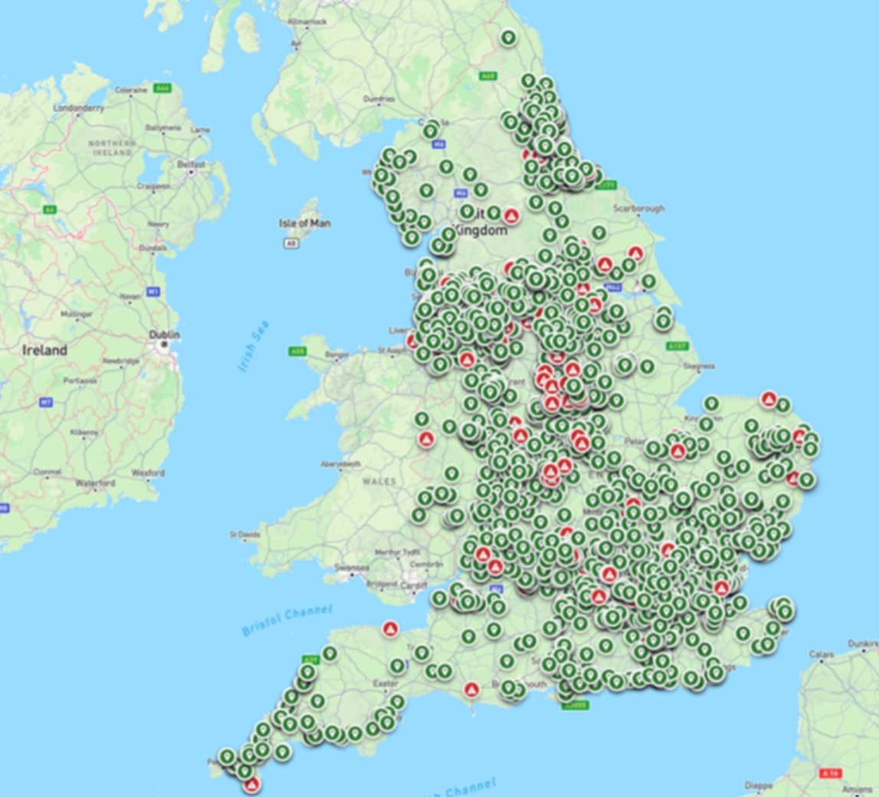
Material Classification Protocol
Overview – what is the Protocol for?
The Protocol requires organisations to:
Record desktop risk assessment of sites at the planning stage (high / medium / low risk)
Visually assess all excavated waste materials (hazardous / inert), recording the classification outcome
Complete 1% UKAS laboratory testing annually of typical excavation volumes (hazardous / inert), to validate the accuracy of visual assessment
Upload all UKAS lab test results (inert / hazardous) to Street Manager regularly, building a national in-ground hazard map
Share outcomes of the above with Streetworks UK quarterly, allowing data analysis of Protocol performance for EA review

Slide 5
Material Classification Protocol
Annual application process
To register your utility or highway authority organisation to use the Protocol for the year:
Online application form: EXCAVATED WASTE PROTOCOL: ANNUAL REGISTRATION FORM
Data evidence of permit and excavation volumes from 2 years previous must be provided as part of application – e.g. applying for use in 2027 requires 2025 activity data – to accurately determine the number of 1% lab sample submissions required for the year.
Once application has been submitted, SWUK will review and respond typically within 10 working days to confirm successful registration, or discuss any issues.
If you have any questions regarding application, please visit the Streetworks UK protocol website, or contact your sector lead representative.
Urgent issues can be raised to: info@streetworksuk.org.uk

Slide 6

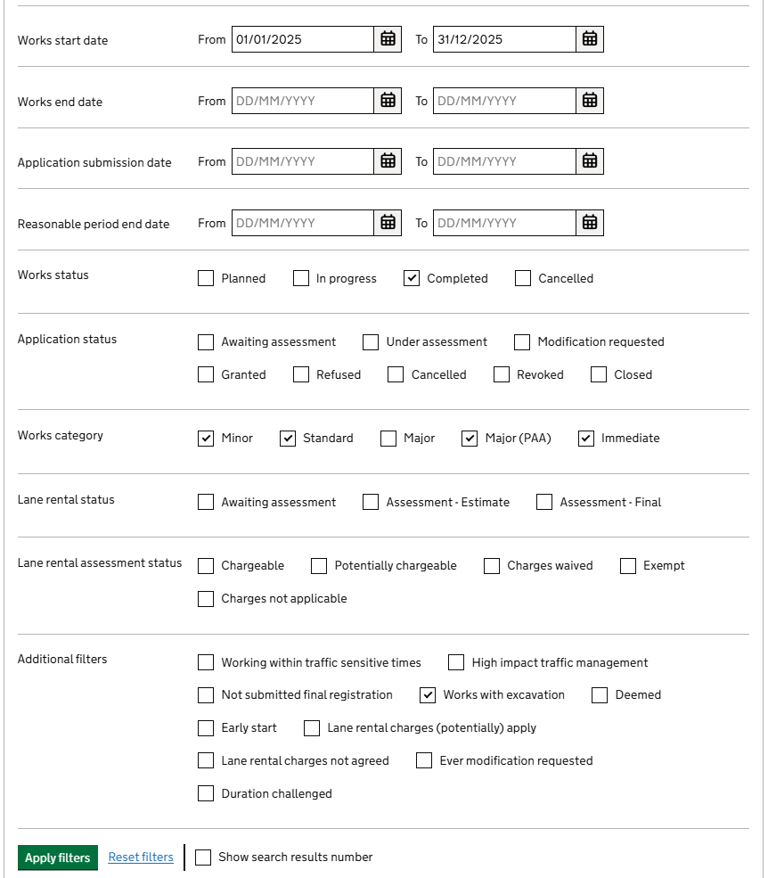
Material Classification Protocol
Extracting application data
Extracting protocol application data from Street Manager:
Permit Volumes
Click ‘Applications and Works’ module
Select filter options:
  Works Start: date range for full year (e.g. 1/1/25 – 31/12/25)
  Works Status: ‘Completed’
  Works Category: select all except ‘Major’
  Additional: select ‘Works with excavation’
Run this report and export data as .CSV – to be copied into Protocol application sheet ‘Permits’ tab.
Please note – if data volumes are high, you may need to run smaller date-range reports (e.g. one per month of the year) to form the full annual set of data required.

Slide 7
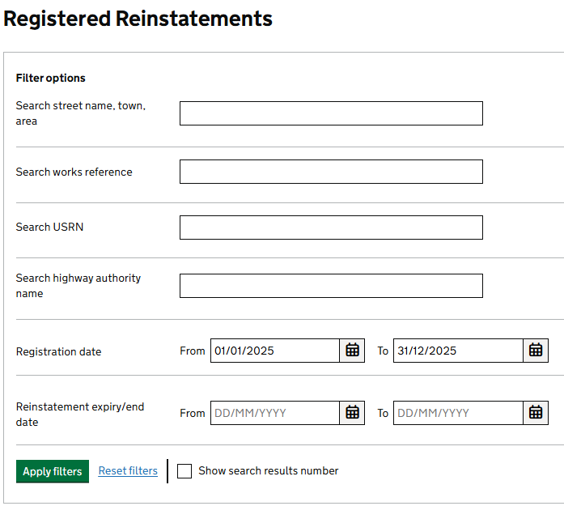
Material Classification Protocol
Extracting application data
Extracting protocol application data from Street Manager:
2) Registration Volumes
Click ‘Registered Reinstatements’ module
Select filter options:
  Registration date: annual date range (e.g 01/01/25 – 31/12/25)
Run this report and export data as .CSV – to be copied into Protocol application sheet ‘Registrations’ tab.
Please note – if registration data volumes are high, you may need to run smaller date-range reports (e.g. one per month of the year) to form the full annual set of data required.

Slide 8
Material Classification Protocol
Quarterly results return process
For all UKAS lab tested excavations, results must be returned to SWUK quarterly of both actual lab findings and desktop / visual assessments recorded. This evidences that your organisation is using the protocol correctly, and provides a classification success metric for the EA.
Online quarterly submission form: https://docs.google.com/forms/d/e/1FAIpQLSdqT2qHthEWqIpR2Sexe2wLhVaEPBLd5STk_JfOcKwAht0w8Q/viewform?usp=dialog
Quarterly submission sheet: http://streetworks.org.uk/wp-content/uploads/2026/10/Excavated-Materials-Protocol-Quarterly-results-return-ORG-NAME-QUARTER-YEAR.xlsx
Once your quarterly return has been submitted, SWUK will confirm receipt.
Please note – if there is missing data or other any issue with submission, your quarterly data may be rejected; SWUK will contact you if this is the case.
If you have any questions regarding quarterly return, please visit the Streetworks UK protocol website, or contact your sector lead representative.
Urgent issues can be raised to: info@streetworksuk.org.uk

Slide 9
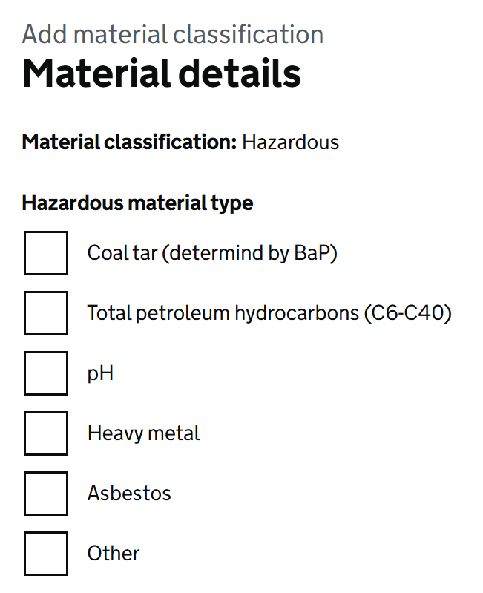
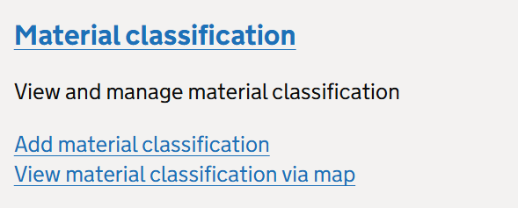
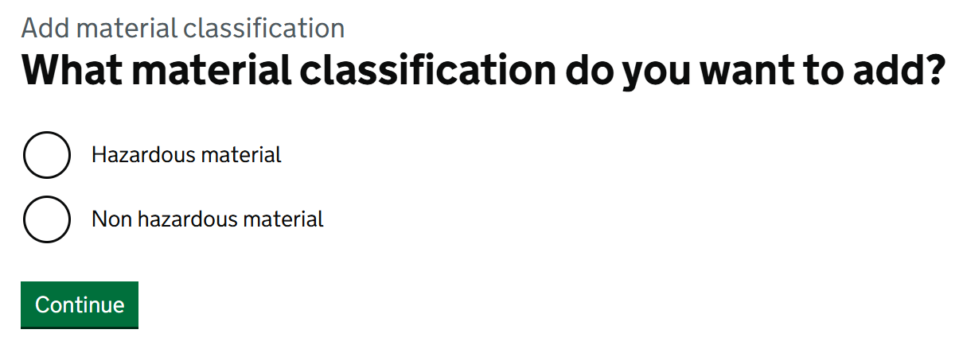
Material Classification Protocol
Uploading UKAS results to Street Manager
All UKAS lab results (hazardous / inert) must be uploaded to Street Manager at the earliest possible time, to support future industry applications:
Under ‘Material Classification’ module, click ‘Add material classification’
Search for your location (by URSN, postcode, etc.)
Click ‘Drop Pin’ and confirm
Select ‘Hazardous’ or ‘Non Hazardous’ material to add record details for
Use UKAS lab details to complete the required fields fully
Submit – your record will be added to the national database

Slide 10
Material Classification Protocol
Sector contacts / further information
Lead working group contacts for each utility sector and highway authority region will be able to offer first-step assistance:
If you have an urgent issue that cannot be resolved, please contact info@streetworks.org.uk
Full information can be found on the Protocol pages of the SWUK website: Street Works UK: Material Classification Protocol - Streetworks
FAQs are routinely updated on SWUK website: Street-Works-UK-Protocol-FAQ-Updates-18-11-25 - Streetworks
UTILITY SECTOR | WORKING GROUP LEAD
ELECTRICITY | TBC
GAS | TBC
TELECOMS | TBC
WATER | TBC
EV OPERATORS | TBC
HIGHWAY AUTHORITY REGION | WORKING GROUP LEAD
LONDON | TBC
NORTH | TBC
EAST | TBC
SOUTH | TBC
WEST | TBC

Slide 11
Material Classification Protocol
Thanks

